Slide 1
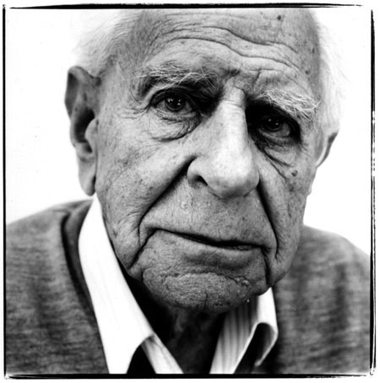
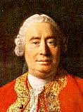
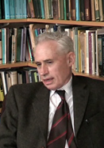
The Cosmological Argument
Starter: Two minutes to examine your essays. Remind yourself of the key criticisms from Hume and others.

Slide 2
Which of these are criticisms of the cosmological argument?
Hume’s Fallacy of Composition
Leibniz’s Principle of Sufficient Reason
Hume’s reference to ‘inductive leaps’.
Russell’s ‘brute fact’
WIPEOUT
Hume’s critique of empiricism/a Posteriori reasoning.
Pascal’s belief that you cannot logically prove God’s existence.
Coincides with the Big Bang & Genesis 1:1
WIPEOUT
Hume’s ‘apprentice Gods’
Russell’s observation: ‘just because all men have mothers, doesn’t mean that mankind itself has a mother’.
Popper and Russell’s observations of inductive arguments.
Swinburne’s application of Ockham’s Razor
The impossibility of infinity.
WIPEOUT
WIPEOUT
Notes:
Wipeout: I plan to use this by asking students in teams of three to name the amount they think they can correctly identify. This will encourage group revision of key criticisms. Then gain feedback from the groups by asking them to explain which are criticisms and why they are criticisms. Possible ext: rate them according to how damaging they are to the argument. Draw out understanding of LEIBNIZ in order to set up understanding of Russell and Coplestone.

Slide 3
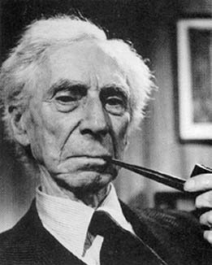
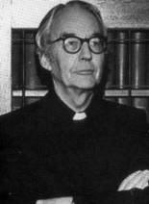
The Cosmological Argument
Russell Vs. Copleston
1948…. Radio Debate… Two eminent philosophers…. Does God exist? … Who will win?

Slide 4
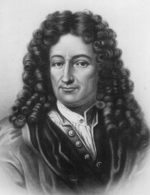
The Principle of Sufficient Reason
In order to understand the debate between Russell and Coplestone you need to be aware of Leibniz’s Principle of Sufficient Reason.
He stated:
‘in virtue of which we hold that no fact could ever be true of or existent, nor statement correct, unless there were a sufficient reason why it was thus and not otherwise.’
What do you think Leibniz means here?

Slide 5
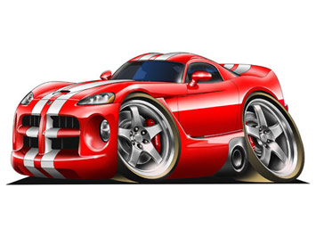
The Principle of Sufficient Reason
‘in virtue of which we hold that no fact could ever be true of or existent, nor statement correct, unless there were a sufficient reason why it was thus and not otherwise.’
Simply put: ‘no fact could ever be true…unless there were a sufficient reason why it was…’
Leibniz means that you should be able to give an explanation of why something is in order to have a sufficient explanation.
Notes:
Car example: the reason why the car exists is because….it was built etc.

Slide 6
What is the sufficient reason for…
…that no fact could ever be true unless there were a sufficient reason why it was…
A kitten…

Slide 7
What is the sufficient reason for…
…that no fact could ever be true unless there were a sufficient reason why it was…
Fire…

Slide 8
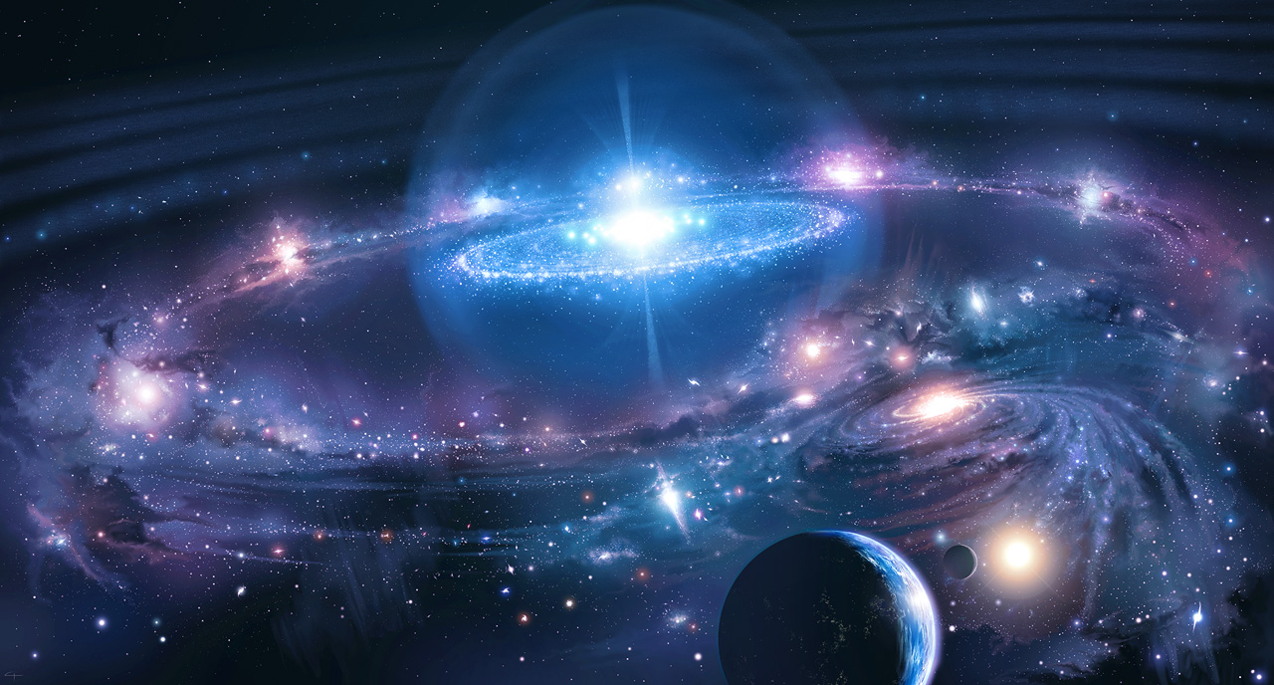
What is the sufficient reason for…
…that no fact could ever be true unless there were a sufficient reason why it was…
The Universe…
Notes:
Ext: what are the problems with trying to give a sufficient reason? How do we know when we have achieved a sufficient reason?

Slide 9
What is the sufficient reason for the universe
…that no fact could ever be true unless there were a sufficient reason why it was…
It is not enough to know how the universe came to exist…we must know why it exists…
This will give us a sufficient reason.
What is a sufficient reason to explain the existence of the universe?

Slide 10
The Debate
In pairs: read through the extract from the debate and outline Coplestone’s Cosmological Argument. Set it out using the formula P1, P2, P3, C1.

Slide 11
THE ARGUMENT FROM CONTINGENCY Copleston: Well, for clarity's sake, I'll divide the argument into distinct stages. First of all, I should say, we know that there are at least some beings in the world which do not contain in themselves the reason for their existence. For example, I depend on my parents, and now on the air, and on food, and so on. Now, secondly, the world is simply the real or imagined totality or aggregate of individual objects, none of which contain in themselves alone the reason for their existence. There isn't any world distinct from the objects which form it, any more than the human race is something apart from the members. Therefore, I should say, since objects or events exist, and since no object of experience contains within itself reason of its existence, this reason, the totality of objects, must have a reason external to itself. That reason must be an existent being. Well, this being is either itself the reason for its own existence, or it is not. If it is, well and good. If it is not, then we must proceed farther. But if we proceed to infinity in that sense, then there's no explanation of existence at all. So, I should say, in order to explain existence, we must come to a being which contains within itself the reason for its own existence, that is to say, which cannot not exist.
According to Copleston, what is the only ‘sufficient reason’ for the universe?
In what way(s) is this similar to Aquinas’ argument from contingency?

Slide 12
THE ARGUMENT FROM CONTINGENCY Copleston:
P1: we know that there are at least some beings in the world which do not contain in themselves the reason for their existence.
P2: the world is simply the real or imagined totality or aggregate of individual objects, none of which contain in themselves alone the reason for their existence.
P3: since objects or events exist, and since no object of experience contains within itself reason of its existence, this reason, the totality of objects, must have a reason external to itself.
C1: That reason must be an existent being.
C2: Well, this being is either itself the reason for its own existence, or it is not. If it is, well and good. If it is not, then we must proceed farther. But if we proceed to infinity in that sense, then there's no explanation of existence at all. So, I should say, in order to explain existence, we must come to a being which contains within itself the reason for its own existence, that is to say, which cannot not exist.

Slide 13
Step 1: the Principle of Sufficient Reason
Russell and Copleston agree that the key to the success of the argument from contingency relies on the acceptance of God being the only sufficient reason for the existence of the universe.
Both Copleston and Aquinas argue that the universe can only be sufficiently explained by reference to God.

Slide 14
Step 1: the Principle of Sufficient Reason
For Aquinas and Coplseton, God (as a necessary being) is the only sufficient reason for the universe.
This is because without a necessary being there would only ever be contingent beings…and of course it is not logical to suggest that contingent beings can cause themselves.
Thus without God there would be no universe.
What do you think Aquinas and Copleston mean by a ‘necessary being’.
How does a necessary being provide us with a ‘sufficient reason’?

Slide 15
Step 1: the Principle of Sufficient Reason
The necessary being, God, according to the Cosmological Argument provides us with a sufficient reason as to why there is something rather than nothing.

Slide 16
Step 2: What is a Sufficient Reason?
Russell questions ‘what do you mean by sufficient reason? You don’t mean cause?’.
He is challenging Copleston’s position by questioning why God must be the sufficient cause.
He asks ‘when is an explanation adequate?’ and uses the example of making a flame with a match.
What Russell is proposing is that there is no need to look to the argument from contingency (GOD) when trying to fulfil Leibniz’s principle and when trying to provide an explanation of the universe.
Notes:
When presenting the match example (use a match): ask students at what stage they think we have provided a sufficient explanation for the flame. Then apply to the argument from contingency. E.g. does a reference to infinity provide us with a full or sufficient explanation?

Slide 17
Step 2: What is a Sufficient Reason?
In response to Russell, Copleston states ‘an adequate explanation must ultimately be a total explanation, to which nothing further can be added’.
Q. How does God fulfil this definition of a sufficient reason?
Q. Can you think of any alternative reasons for the universe that we could identify as ‘sufficient’?

Slide 18
Step 3: Is it even possible to reach a sufficient reason?
Russell responds by saying that ‘you’re looking for something which can’t be got, and which one ought not to expect to get’.
Q. What do you think Russell means here?
Q. Why might he say this?

Slide 19
Step 3: Is it even possible to reach a sufficient reason?
Russell is suggesting that it is not possible to reach a ‘sufficient reason’ for the universe.
He basis this on his empirical/agnostic stance. He maintains that as the reason is beyond human experience we can never gain a sufficient reason for the existence of the universe.
‘I should say that the universe is just there and that is all’.
What are your thoughts on this perspective?
Is Russell justified in saying that we cannot gain knowledge of that which is beyond our understanding?
Does this mean that it is meaningless to talk of metaphysics or even God?
Notes:
Discuss answers: encourage G&T to explore 3. in more detail. Link to religious language.

Slide 20
Step 3: Is it even possible to reach a sufficient reason?
Copleston’s response is…
To defend the argument from contingency (as previously explored)
To call Russell dogmatic.
He states ‘if one does not wish to embark on the path which leads to the affirmation of a transcendent being, however the latter may be described, one has to deny the reality of the problem and assert that things ‘just are’ and that the existential problem in question is just a pseudo-problem. And if one refuses to even sit down at the chess board and make a move, one cannot, of course, be checkmated.’

Slide 21
Reviewing Learning
AO1 Test.
List two facts about a) Russell and b) Copleston. [4]
What is Leibniz’s Principle of Sufficient Reason? [3]
What is a necessary being? [2]
Explain one reason why Copleston believes that God is the only possible sufficient reason for the universe. [3]
Explain one reason why Russell believes that the universe itself (it ‘just is’) is a sufficient reason. [3]
Total: /15

