Slide 1
Living the Christian life
Revision

Slide 2
Main Topics
The meaning and importance of vocation
How and why Christians show vocation in daily life and work
How and why some Christians show vocation by taking holy orders
How and why some Christians are involved in working for community cohesion
How and why Christians use the Ten Commandments as a guide for living
How and why Christians use the Sermon on the Mount as a guide for living
How and why one Catholic organisation helps to relieve poverty and suffering in the UK
Living the Christian Life

Slide 3
The meaning and importance of vocation
A Christian’s vocation is a call to discipleship and to be a witness to his or her faith.
Vocation is important because Christians believe that it leads them into a life where they serve God, others and live in the way that God wants.
This will eventually lead to a life in God’s Kingdom.

Slide 4
How and why Christians show vocation in daily life and work
Christians show vocation in their daily life and work in many different ways.
It can be by the job they choose such as a doctor, teacher or carer. Or it can be the way they treat people and live their life.
It is important for Christians to show their vocation in their daily life because vocation means serving God in everything you do.

Slide 5
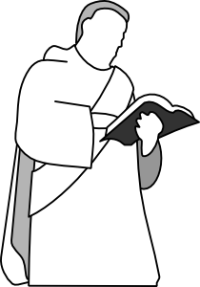
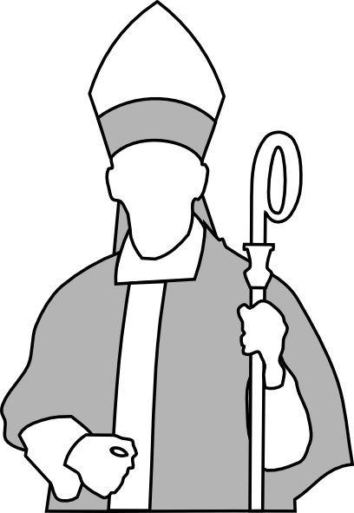
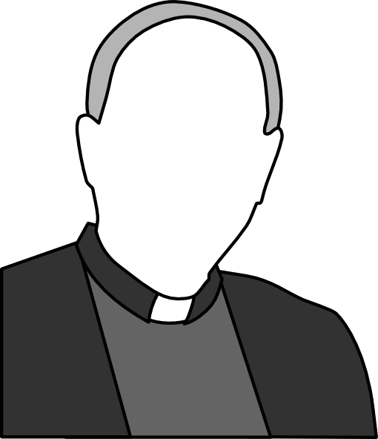
How and why some Christians show vocation by taking holy orders
Some men receive a special vocation from God to take the sacrament of holy orders and devote their life to God as a deacon, priest or bishop.
Holy orders means that a man has a vocation of discipleship and witness and he does this by serving the Church as an ordained minster.

Slide 6
How and why some Christians are involved in working for community cohesion
Individual Christians work for cohesion by making friends with people of different ethnic groups.
The Catholic Education Service does it by encouraging study of non-Christian religions and banning racism in schools.
Churches Together encourages different ethnic groups to work together and organises joint Christian responses to social issues.
Some Christian groups support local projects.
Christians do this work to follow the teachings of the Bible and Jesus and because it is the teaching of the Church.

Slide 7
How and why Christians use the Ten Commandments as a guide for living
Christians use the Ten Commandments to help them worship one God, avoid swearing, honour parents and live a good Christian life.
They use the commandments as a guide for living because they are precise rules about how to respect God, how to behave and how to regard possessions.

Slide 8
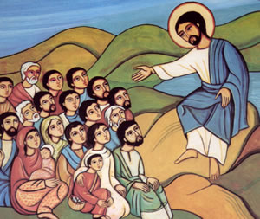
How and why Christians use the Sermon on the Mount as a guide for living
Christians use the teachings on displaying religion to decide how they should pray, fast, give to charity and worship God.
They use them because they are the teachings of God’s Son, Jesus, on how to live.

Slide 9
How and why one Catholic organisation helps to relieve poverty and suffering in the UK
The SVP or St. Vincent de Paul Society is a Catholic organisation that works in small groups mainly based in parishes.
The members try to relieve poverty and suffering in many ways but mostly by visiting people and providing them with practical guidance.
They do this by following the example of Jesus who healed the suffering.
They try to follow the teachings of The Sermon on the Mount and different parables.
They are also following the teachings of the Catechism.

