Slide 1
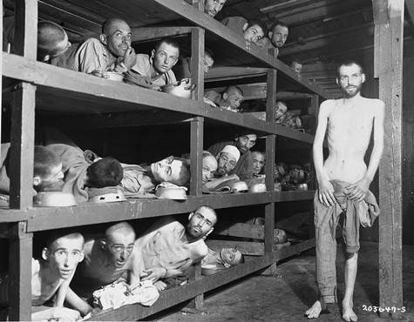
Evil and Suffering
Edexcel AS -LEVEL

Slide 2
Evil
Evil: “physical pain, mental suffering and moral wickedness”(John Hick, Philosophy and Religion)
Four types of evil :
Natural - malfunctioning of the natural world (John Hick)
Moral - “evil caused deliberately by humans doing what they ought not to do, or allowed to occur by humans negligently failing to do what they ought to do” Richard Swinburne
Physical - the experience of evil in physical form
Meta-physical - imperfection and contingency as a feature of the cosmos (e.g. death would be a metaphysical evil
Suffering = the unjust result of evil, manifested in mental or physical terms

Slide 3
The Problem
Christian theists wish to maintain that the God of classical theism is a true reality…
He is assumed to be omnipotent, omnibenevolent and omniscient.
However, the existence of evil and suffering causes a major problem for the believer…
As St Augustine of Hippo (4th century) wrote in his ‘Confessions’….
“Either God cannot abolish evil or he will not; if he cannot he is not all-powerful, if he will not, he is not all good”.

Slide 4
The logical problem of evil and suffering
J.L. Mackie and the ‘Inconsistent Triad’ (from ‘Evil and Omnipotence’, 1955)
God’s omnipotence
Evil Exists God’s omnibenevolence
The combination of any of these two positions leads logically to the third being impossible.
However, theists wish to maintain that all three positions are true whilst still believing that God exists.
This presents an issue…..

Slide 5
Issues resulting from the inconsistent triad….
God is omnipotent: so he should be able to destroy evil as he is all powerful
God is omnibenevolent: so he would wish to destroy evil as he would not wish any of his subjects to endure suffering
Furthermore, (though not contained within the triad), God is omniscient and so would possess the knowledge to destroy evil as he is omniscient.
God created the world ‘ex nihilo’, from nothing, and is therefore responsible for everything within it.
Evil does exist - therefore the God of classical theism cannot exist

Slide 6
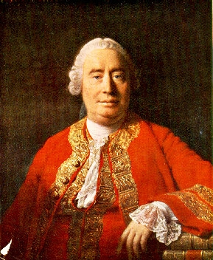
David Hume and the Existence of Evil
Hume used the logical problem to offer an deductive argument for the non-existence of God.
P Evil exists
P A God, who is all-loving and all-powerful, would not allow evil to exist if he was real
C A God, who is both omnipotent and omnibenevolent therefore does not exist

Slide 7
The evidential problem
The sheer amount of evil and suffering present within the world cannot be reconciled with the God of classical theism
a small amount of evil might be tolerated to…
distinguish between right and wrong
to provide motivation for believers to ‘do the right thing’
or to highlight God’s goodness
However, it is not clear why God permits, in some instances large amounts of suffering, e.g. the Holocaust
The evidence of unnecessary evil suggests that God does not exist

Slide 8
Responses to the Problem: ‘Theodicies’
In light of the problem of evil and suffering, theologians have developed a number of ‘theodicies’ in defence of the God of classical theism.
Theodicy was a word coined by Leibniz and literally means a “defence of God’s righteousness” (theos = God, dike = righteousness)
We will examine three:
The Augustinian Theodicy
The Irenaen Theodicy
Process Theology

Slide 9
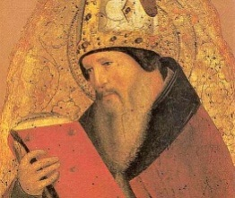
The Augustinian Theodicy
Developed by St Augustine of Hippo in his ‘Confessions’ - known as a ‘soul-deciding’ theodicy.
Augustine argues that the world created good as reflected in the Bible (“and god saw that his creation was good”)
Man created in a state of perfection as part of the hierarchy of being (explain)
However he was also created free – this leads to ‘the Fall’, ‘Original Sin’, and man turning away from God (explain Adam+Eve)
Evil not a substance or physical entity but a privation of good, a privatio bonni, as a result of one of God’s creation turning away from the hierarchy of being – nothing, however is entirely evil
Those that turn back to God will proceed to heaven; those that do not will suffer eternal torment (soul-deciding)
Natural evil is a result of ‘satan and his cohorts’ turning away from their role in creation and placing their pride over good
“since there is happiness for those that do not sin, the world is perfect”
The aesthetic argument: the universe like a canvas – overall the canvas is good – however, from our perspective close up, it might seem evil.

Slide 10
…
Strength of Augustine’s theory God’s omnipotence and omnibenevolence are protected as moral responsibility rests with humanity not God – which directly supports biblical account of creation (Genesis)
Strength: Free-will makes the relationship between man and God more genuine as man acts out of conviction as opposed to being programmed like a robot to perform moral actions.
Strength: Augustine’s theory recognises the saving power of Jesus Christ and therefore provides motivation for man to act morally
Strength: Evil and suffering have a purpose as suggested by the aesthetic argument: the presence of evil distinguishes between good and evil is a necessary part of creation which, overall, is good.

Slide 11
Weaknesses of Augustine’s theory: Why would a ‘perfect’ creation, regardless of free-will, act immorally and turn away from him? Is God’s notion of perfection either wrong or perverse?
God’s omniscience appears to have been compromised, as if he was all-knowing he would have foreseen man’s errors and adjusted creation.
Is the definition of evil as merely an ‘absence of good’ morally justifiable? Some would feel that this is too weak a definition and that suffering is a true physical entity
The notion of the fall is at odds with evolutionary biology which states that far from beginning with ‘the Fall’, man develops as a result of greater and greater intelligence and complexity towards perfection
Hick argues against the Augustinian aesthetic argument that suffering in many of its forms seems to be DYSteleological (ie it serves little purpose), contrary to Augustine’s claims.

Slide 12
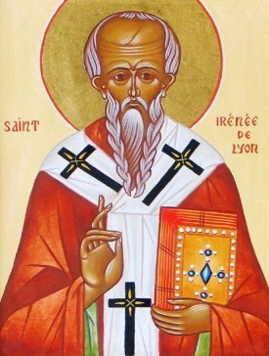
The Irenaean Theodicy
Irenaeus, 2nd century Christian apologist, developed a ‘soul-making’
theodicy in ‘Against Heresies’
The world and mankind created with free will but not perfect (though God could have created him such being omnipotent)
Mankind created in the image of God, but not the likeness of God – he is immature and imperfect.
Life therefore a testing ground, within which man can grow into the likeness of God. Adam and Eve’s sin was not a catastrophe as with Augustine, but the childish mistake of an immature being growing in moral knowledge
For man to do this, God must give humanity free will, so that he can genuinely choose right from wrong
John Hick’s development: life allows for moral and spiritual growth in the “vale of soul-making” (explain).
Man created at an “epistemic distance” – the purpose of which was to allow man to freely come into knowledge of God by acting morally – as we mature, the distance weakens
The product of this is a free, genuine and valuable relationship with God: man becomes, as Hick argues “children of God” and heirs of “eternal life”

Slide 13
Strengths of Irenaeus’ theodicy: Irenaeus’ theodicy avoids the issue of a perfect creation turning away from God whilst also allowing for free-will and God’s omni characteristics
Irenaeus’ theodicy allows for the humanity to recognise the value of a relationship with God. If God’s love was freely given, it would be of less value. (as Hick argues, otherwise man becomes like a “robot”)
Irenaeus provides a recognisable and achievable goal for humanity that stresses the relevance and value of life on earth perhaps more than Augustine’s theodicy does.
Because God creates the universe and humanity out of imperfect matter, Irenaeus’ thodicy avoids the issue that God creates ‘ex nihilo’, and that he is therefore wholly responsible for the introduction of evil into the world.
Irenaeus’/Hick’s concept of the universe as the vale of soul-making is the “best possible universe”: a world without free will would lack value / a world without error would not be one in which man possesses free will

Slide 14
Weaknesses of Irenaeus’ theodicy: The view of creation presented by Irenaeus is radically at odds with the Biblical account in which man is created perfectly. It is certainly not to be considered wholly ‘orthodox’.
The significance of Christ’s sacrifice is devalued as humanity’s moral perfection is guaranteed as an end result.
If the end result of man reaching God by weakening the epistemic distance is already assured, how can philosophers maintain that humanity possesses free-will.
Can the end justify the means? Is it satisfactory to state that all the suffering experienced within the world is justifiable because it will lead to knowledge of God and moral perfection.
God creates the world out of pre-existent matter which challenges the idea that he is omnipotent as he is no longer the source of everything (contrary to Augustine’s view).

Slide 15
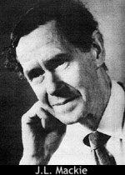
J.L Mackie’s criticism of the idea of free-will
The modern philosopher, J L Mackie, has criticised this by arguing that in addition to a world of robots without free will, and a world of free will but evil, God had a third option – a world where people always freely choose good things over bad. His argument goes as follows;
It is logically possible for me to choose to do good on any one occasion.
It is logically possible for me to choose to do good on very occasion.
It is logically possible for any individual to choose to do good throughout their life.
God is omnipotent and can create any logically possible world.
Therefore God could have created a world in which we were all genuinely free, yet we all chose to do good.
God did not create such a world.
Therefore either God is not omnipotent, or he is not wholly good.

Slide 16
Process Theology
Developed by A.N. Whitehead in the 20th century
Unlike for both Augustine and Irenaeus, God is NOT omnipotent
God creates order out of pre-existing chaos; he is therefore not a creator “ex nihilo”
Rather than creating the world and leaving it to its own devices, God is continually part of the unfolding process of creation
When the process is harmonious, it produces good; when it produces discord, it produces evil
God is partly involved with creation (his physical attributes), and partly distinct (his mental attributes), using “persuasion and lure” (John Hick) to maximise good over evil
God tries to coax humanity into choosing good, however he does not possess total control over us
Most importantly, God suffers when the world suffers through evil – rather than remaining transcendent and omnipotent, he is, as Whitehead argued, the “fellow sufferer who understands”.
God remains responsible for good and evil, however this is justified by Hick thus: God has “produced a sufficient quality and quantity of good to outweigh all the evil”.
The theory gained particular favour in light of the holocaust: Jurgen Moltmann described Jesus Christ as the suffering servant on the cross who experienced and suffered alongside the Jews in the holocaust.

Slide 17
Evaluation of Process Theology
Strengths:
God is sympathetic to our suffering; he engages with suffering along with the world
The theory provides an answer to the issue of God and the Holocaust (and why he did not stop such evil from occurring)
The theory still allows for a form of free will whilst redefining God’s nature in more accessible terms
Weaknesses:
It is not strictly a theodicy as God’s character has been redefined
Is a God who is not omnipotent worthy of worship?
It contradicts the scriptural account of creation

Slide 18
Past Exam Questions
1a) In what ways may suffering cause problems for religious believers? Outline two solutions to these problems. (21)
1b)To what extent are these solutions successful? (9)

Slide 19
2a) Identify key ideas associated with the problem of evil and suffering. Examine two solutions to the problem of evil and suffering. (21)
2b) Comment on the view that these are only partially successful solutions (9)

Slide 20
3a) ‘Suffering is a major problem for religious belief but there are solutions’. Examine two solutions to this problem. (21)
3b) Comment on the view that nevertheless suffering remains a major problem for religious belief. (9)

Slide 21
4a) ‘Either God cannot abolish evil or he will not. If he cannot, he is not omnipotent, if he will not he is not omnibenevolent’. Examine this claim and give one solution this problem.
4b) Comment on the strengths and weaknesses of a different solution to that presented in part 1 (9)

Slide 22
5a) What may the problem of suffering signify to a religious believer? Examine one solution to this problem. (21)
5b) Comment on the view that an alternative solution to that offered in part 1 a better response. (9)

