Slide 1
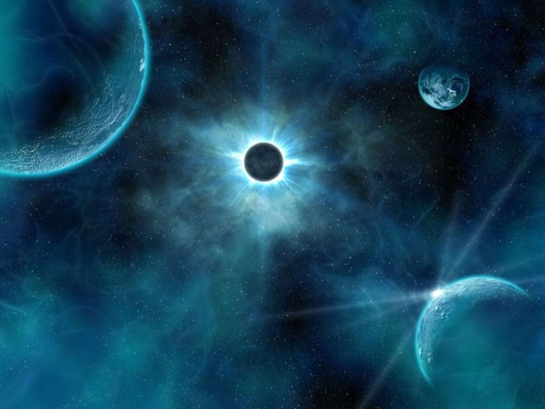
The Cosmological Argument
AS

Slide 2
Background to the Argument
A classical theistic proof for the existence of God
Supports the concept of the God of classical theism (omni-words)
Accepts that the cosmos is contingent upon a prior being to bring it into existence
Locates this deity outside of the universe as an eternal, all powerful, first cause
Developed by the likes of Al Kindi, Thomas Aquinas, Gottfried Leibniz and FR Copleston

Slide 3
Background Scholars
Plato, 5/4th century BCE….
“Shall we say that it is a soul which controls heaven and earth?”…..
Plato argues that there must be a prime mover who is capable of moving himself and all other things within the universe (which count as secondary movers as they can move others but not themselves)
Aristotle, 3rd century BCE….
“the series must start with something, since nothing comes
from nothing”.
Aristotle argues there must be an ultimate source to all change

Slide 4
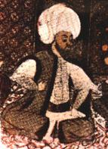
Al Kindi’s Kalam Argument
Al Kindi, 801-873CE, (known as “the philosopher of the Arabs”) develops Aristotle’s/Plato’s ideas in the form an inductive philosophical argument, known as the Kalam argument…
P: Nothing that exists can cause itself
P: The world exists
P: The world must have been caused
C: This cause was God

Slide 5
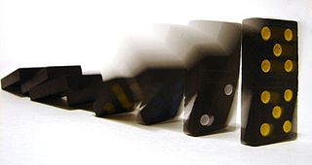
Thomas Aquinas’ First Way
Thomas Aquinas (1225-1274) was a Dominican priest, philosopher and theologian who developed five proofs known as the ‘Quinque Viae’ for the existence of God in his ‘Summa Theologica’.
The “First Way” or the “Unmoved Mover”:
P: Everything that possesses motion requires a prior cause to put it into motion
P: The world is in motion
P: Infinite regress is impossible
P: The world therefore requires a prior cause to put it into motion
P: This prior cause must transcend the world
C: This cause is God who is the “unmoved mover”

Slide 6
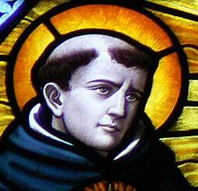
Thomas Aquinas’ 2nd Way
The “Second Way” or the “Uncaused Causer”:
Similar to the first way, the second way posits God as the primary cause to the universe, this time focusing specifically on cause and effect.
P: Everything that exists must have a prior cause.
P: Things in the world exist, each requiring a prior cause.
P: This chain of cause and effect cannot go on to infinity (rejection of infinite regress)
P: The world must have had a first cause which itself was uncaused.
P: This cause must lie outside of the universe.
C: This cause is God who is the “uncaused causer”.

Slide 7
Thomas Aquinas’ Third Way
The Third Way or “The Argument from Contingency”
This version rests upon the belief that the cosmos is dependent and finite.
P: Everything within nature which now exists has not always existed
P: Every object/being is dependent upon a prior contingent, finite being
P: This cannot go on to infinity
P: There must be one being who is not contingent but which has always existed and is not dependent upon any other for its existence
P: This being must lie beyond the universe
C: This being is God who is labelled a “necessary being”; one who is eternal, uncaused and unique.

Slide 8
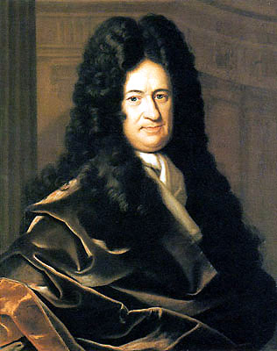
Gottfried Leibniz and the ‘Principle of Sufficient Reason’
Leibniz avoided looking at single instances of effect within the universe such as objects in motion, and instead focused upon an explanation for the whole cosmos:
“If you suppose the world eternal, you will suppose nothing but a succession of states, and will not find in any a sufficient reason”.
P: For everything that exists there must be a sufficient reason to account for its existence
P: The world exists, but contains no sufficient explanation within it for this existence
P: The explanation for the world must lie outside of it
C: The sufficient explanation must be God

Slide 9
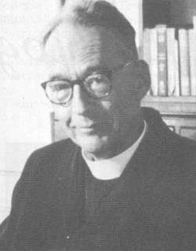
F.C. Copleston
F.C. Copleston was a 20th c. Jesuit priest who famously defended the idea of a creator God who causes the cosmos in a radio interview with the famous philosopher Bertrand Russell in 1947.
“There needs to be a necessary being to explain why everything else exists. Contingent beings (like everything we know in the universe) lack the ‘sufficient reason’ to explain why they exist”
Copleston borrows from both Aquinas’ 3rd way and Leibniz
P: Everything in the universe is contingent
P: Contingent things do not act as a sufficient explanation for their own existence
P: The universe, because it is contingent, cannot contain anything that explains its own existence
P: There must be a necessary being outside the universe that constitutes a sufficient reason for the universe’s existence
C: This necessary being is God

Slide 10
Criticism of Al Kindi’s Kalam argument
The challenge of quantum physics – according to quantum physicists, something can come from nothing (electrons passing in and out of existence without any prior cause). This contradicts the first premise of the argument (“nothing comes from nothing”).
The oscillating universe theory – some physicists maintain that the world never “began” as such – the universe is part of an infinite process of expansion and collapse.
The Big Bang as an alternative explanation – did the universe come about as a result of the clashing of sub-atomic matter? If so the idea of a creator God becomes less relevant!

Slide 11
Criticisms of Aquinas’ 1st/2nd Ways
The possibility of an infinite regress – Aquinas reject this but with little justification
Bertrand Russell – the earth is a ‘brute fact’ with no need of explanation in terms of a cause. To attempt to provide an answer is to provide unnecessary meaning and purpose to the world.
The inductive leap – Aquinas moves from inferring that there must be a first cause to the idea that this is the God of classical theism – on what basis or justification?
Contradiction – Aquinas argues that, for example, everything that is in motion must possess a prior cause – and then contradicts this by arguing for the uniqueness of God – on what basis?
Plurality of causes – perhaps there is a cause of the world, but perhaps this cause might be many causes/an imperfect cause etc

Slide 12
Criticisms of Aquinas’ 3rd Way
The notion of a necessary, unique being, is a logical impossibility, at least from our experience
If we assign ‘necessity’ as a characteristic to God, we are no longer presenting an a posteriori argument, or one that follows valid logic
The idea of a necessary being is unverifable and beyond what we know
Aquinas’ argument depends upon the belief, rather than the demonstration, that an infinite regress is impossible

Slide 13
Criticisms of Leibniz/Copleston
David Hume: one can account for single instances of cause and effect, but to ascribe an overall cause to the universe is to go beyond the available evidence
Bertrand Russell supports this: following the logic of the cosmological argument, one might come to the conclusion that because all men have a mother, there must be a mother to all men. This is illogical.
Leibniz’s argument falls prey to its own logic: if God is the sufficient explanation to the universe, what is the sufficient explanation for God?

Slide 14
Responses to Criticisms
J.L Mackie on infinite regress: Mackie provides the analogy of the infinite number of train carriages. An infinite number of these still requires an engine to inject energy.
Reply to Russell on the world as a ‘brute fact’: to ignore the question of how the world arose is to reject a question fundamental to human existence.
Objection to the ‘plurality of causes’ argument: one might apply Ockham’s Razor to the issue of the nature of the first cause (why multiply the cause of the universe when one cause would suffice?).
Objection to quantum physics: William Lane Craig argues that electrons do not pass in and out of existence without a cause but are influenced by vacuum fluctuations.
Objection to the concept of infinity: infinity is an unproven concept – the library with an infinite number of red and green books.

Slide 15
Strengths
The argument provides a solution to one of the deepest of existential questions. This counters Russell’s unwillingness to attempt to find an answer to this as Copleston argues: “If one refuses to sit down at the chess board and make a move, one cannot of course be checkmated”.
The argument follows philosophically sound logic (inductive logic).
The argument, an example of natural theology, compliments revealed theology (as found in the Book of Genesis for example)

Slide 16
Strengths
The argument is grounded in our experience: generally speaking, what comes into existence has a cause
The argument provides evidence that confirms the characteristics of the God of classical theism
The argument avoids the issue that the design argument presents by describing God in anthropomorphic terms: God is presented as wholly other, as described by the likes of Rudolph Otto
The argument supports scientific findings and can be combined with, for example, the Big Bang theory.

Slide 17
Concluding Remarks…
Can it be a proof if it is inductive? It certainly cannot be conclusive!
Unlikely to convert the atheist, likely to strengthen the belief of the theist who is already supportive of the idea of a creator God.
Perhaps best described as an example of “faith seeking understanding” (St Anselm).
“As an argument for the existence of a first cause of all existing things, the arguments seems a reasonable one. But it does not by itself establish the existence of God with all the properties sometimes ascribed to him”.

Slide 18
Past Exam Questions
1a) Give an account of the key features of the cosmological argument for the existence of God (21)
1b) To what extent is this a weak argument? (9)

Slide 19
2a) Examine three of the following in relation to the cosmological argument: unmoved mover, uncaused causer, Kalam argument, necessary being. (21)
2b) Comment on the view that the cosmological argument is open to debate and there are no firm conclusion about its success or failure

Slide 20
3a) What are the main strengths of the cosmological argument for the existence of God? (21)
3b) To what extent is it reasonable to reject this argument? (9)

Slide 21
4a) What are the significant features of the cosmological argument for the existence of God? (21)
4b) How far, if at all, do the strengths of the argument outweigh the weaknesses? (9)

Slide 22
5a) What are the main ideas of the design and the cosmological argument for the existence of God? (21)
5b) Choose one of these and comment on its weaknesses. (9)

